Slide 1

MILITARY COLLEGE OF ELECTRONICS AND MECHANICAL ENGINEERING
FACULTY OF ELECTRONICS
CE DEPARTMENT
COURSE NO. AESC (COMN) – 01 (C)
TECHNICAL PRESENTATION ON
COMMUNICATION EQUIPMENT FOR AIRBORNE EARLY WARNING AND CONTROL
SYNDICATE - 03
CFN SANTRAM
CFN SANDEEP
CFN MHARNOR PRAKSH MANIK
CFN KANDALA KARUNA NAIDU
DIRECTING STAFF
LT COL KUSHAL GANGULY
ASST DIRECTING STAFF
NB SUB K G RAO
HMT S M JAT

Slide 2
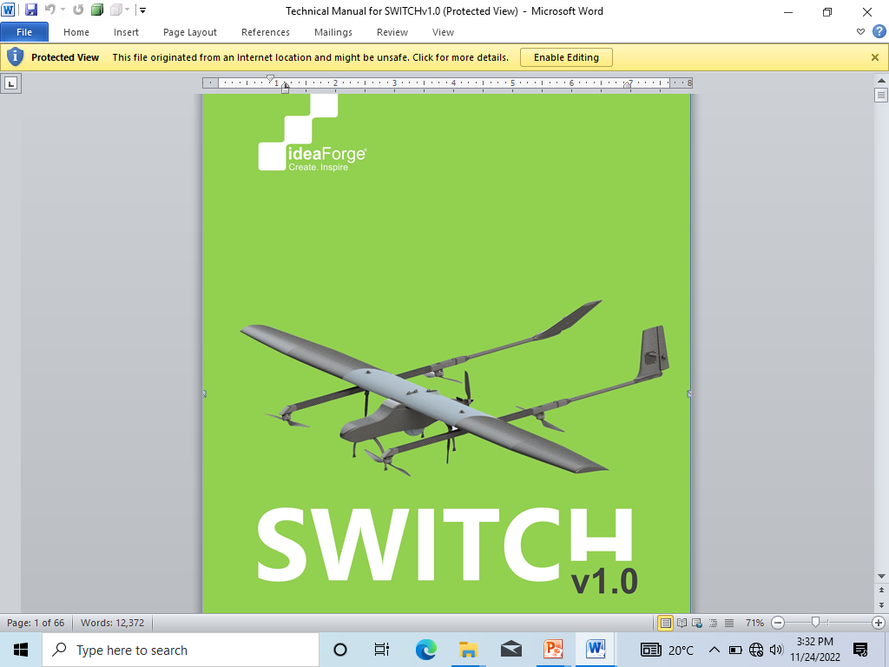
AIM
The Aim of this presentation is about the communication equipment for Airborne Early Warning and Control ( AEW&C ) briefly and acquire knowledge about this equipment.

Slide 3
PREVIEW
INTRODUCTION
KEY COMPONENTS OF AEW&C
COMMUNICATION EQUIPMENT IN AEW&C
WORKING
CURRENT SYSTEMS
APPLICATIONS
ADVANTAGES
DISADVANTAGES
CONCLUSION

Slide 4
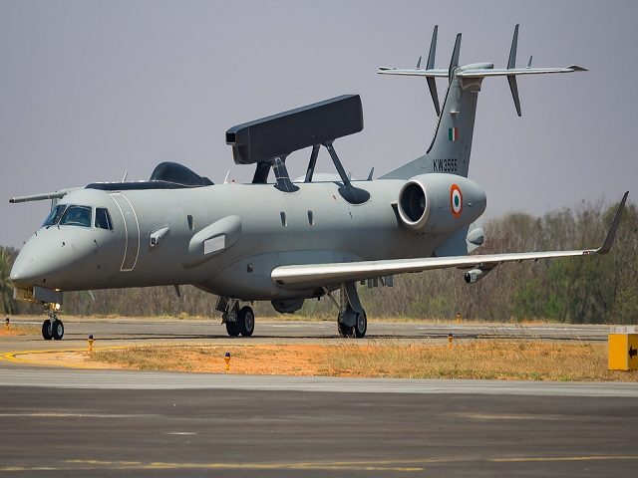
INTRODUCTION
AEW&C is a vital technology for surveillance, reconnaissance, and command and control.
Purpose:
It detects and tracks airborne and surface targets, providing real-time information to enhance decision-making.
Significance:
AEW&C plays a critical role in military defense, disaster response, and airspace management.

Slide 5
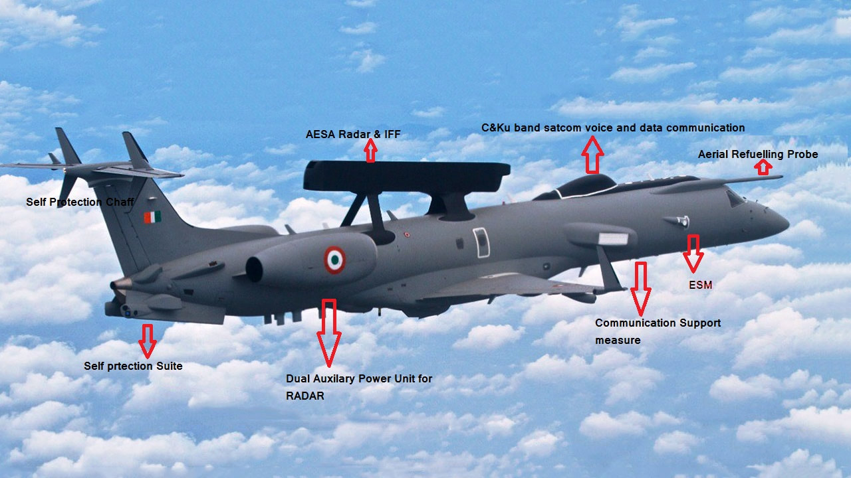
KEY COMPONENTS OF AEW&C

Slide 6
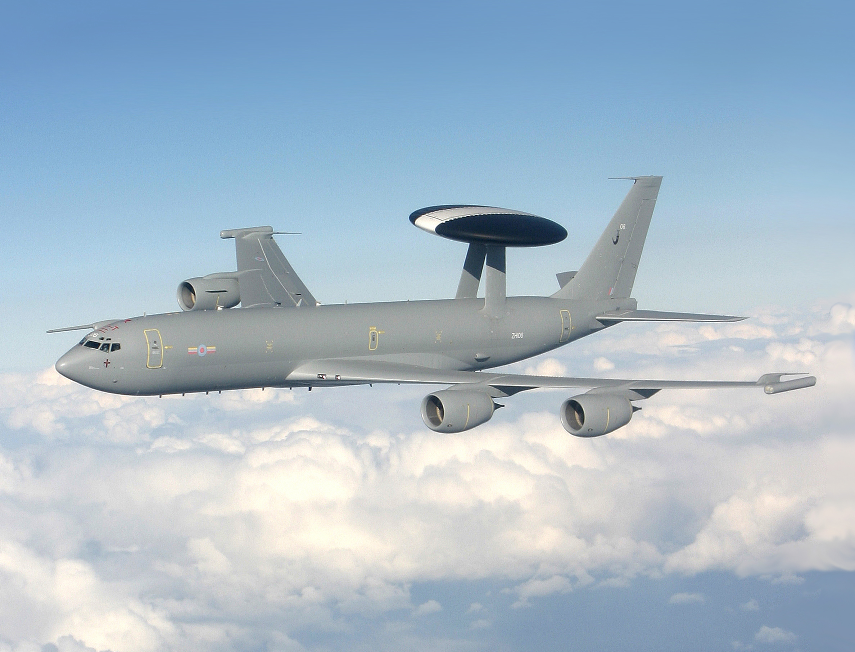
KEY COMPONENTS OF AEW&C
AIRCRAFT PLATFORM: SPECIALIZED AIRCRAFT EQUIPPED WITH RADAR SYSTEMS, SENSORS, AND COMMUNICATION EQUIPMENT.
RADAR SYSTEMS: RADAR TECHNOLOGY FOR LONG-RANGE TARGET DETECTION AND IDENTIFICATION.
COMMUNICATION SYSTEMS: REAL-TIME DATA TRANSMISSION BETWEEN AIRCRAFT AND GROUND STATIONS.

Slide 7
COMMUNICATION EQUIPMENT IN AEW&C
DATA LINKS
ANTENNAS
SATELLITE COMMUNICATION (SATCOM) TERMINALS
ENCRYPTION DEVICES
MULTIPLEXERS AND DATA PROCESSORS
SECURE VOICE COMMUNICATION SYSTEMS
LINE-OF-SIGHT (LOS) RADIOS
GROUND COMMUNICATION STATIONS
REDUNDANCY SYSTEMS

Slide 8
CLASSIFICATION OF UAVs
TARGET AND DECOY – PROVIDE GROUND & AERIAL GUNNERY A TARGET THAT SIMULATES AN ENEMY AIRCRAFT OR MISSILE
RECONNAISSANCE – PROVIDING BATTLE FIELD INTELLIGENCE
BATTLE FIELD INTELLIGENCE – COMBAT PROVIDING ATTACK CAPABILITY FOR RISK MISSIONS
RESEARCH & DEVELOPMENT – FURTHER DEVELOPMENT OF UAV TECHNOLOGIES TO BE INTEGRATED INTO FIELD DEPLOYED UAV AIRCRAFT
CIVIL & COMMERCIAL UAVS – UAV SPECIALLY SPECIFIED FOR CIVIL AND COMMERCIAL APPLICATION

Slide 10
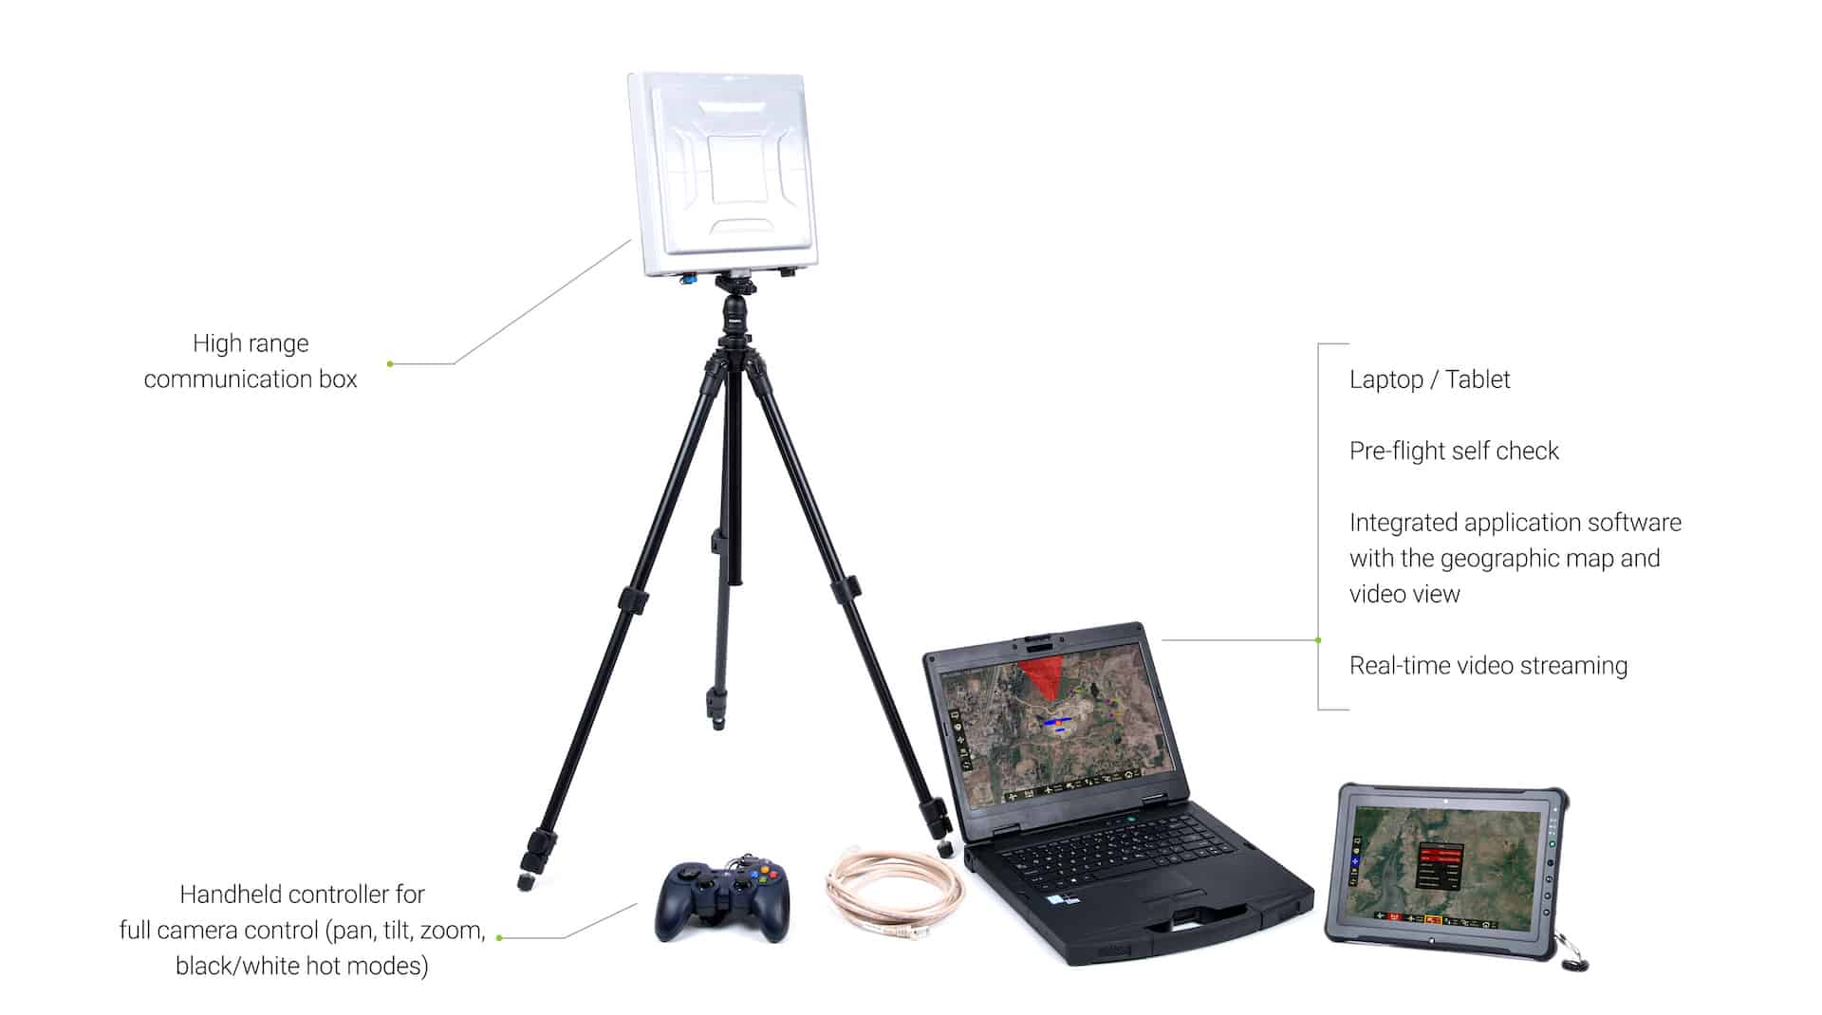
SUB-SYSTEM OF UAV

Slide 11
DESIGN PARAMETERS
AERODYNAMICS
PAYLOAD
ENDURANCE
SPEED & RANGE
COMMUNICATIONS
NAVIGATION SYS
LAUNCH & RECOVERY

Slide 12
APPLICATIONS OF UAV
SEARCH & RESCUE
DISASTER RELIEF
SPORTS
COMMERCIAL AERIAL SURVEILLANCE
COMMERCIAL AND MOTION PICTURE FILMMAKING
ARMED ATTACKS

Slide 13
APPLICATIONS OF UAV
SURVEILLANCE & BORDER PATROL MISSIONS
FOREST FIRE DETECTION
DETECTION OF ILLIGAL HUNTING
FIRE & LARGE ACCIDENT INVESTIGATION
LAND SLIDE MEASUREMENT
ILLIGAL LANDFILL DETECTION
CROWD MONITORING

Slide 14
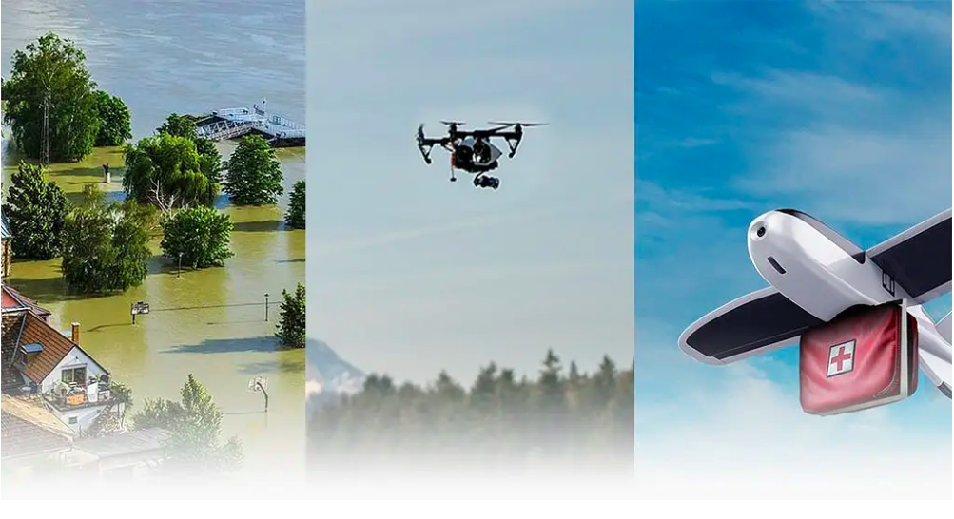
DISASTER RELIEF
UAVs TRANSPORT MEDICINES, VACCINES & RETRIEVE MEDICAL SAMPLES INTO & OUT OF REMOTE OR OTHER IN ACCESSIBLE REGIONS
UAVs CAN HELP IN DISASTER RELIEF BY GETTERING INFORMATION FROM ACROSS AN AFFECTED AREA

Slide 15
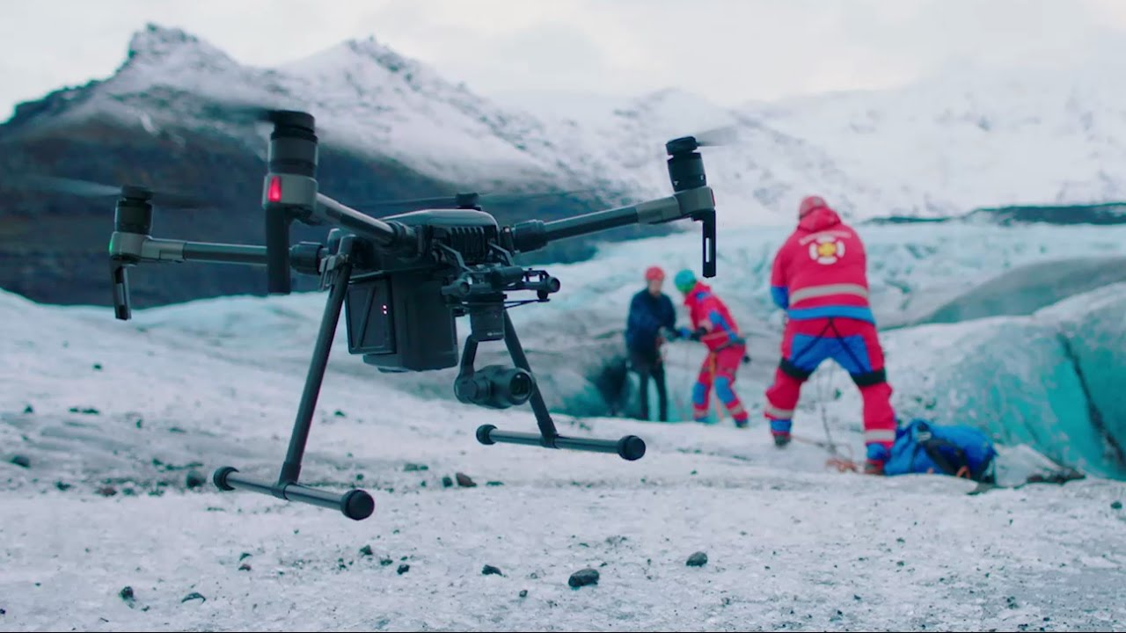
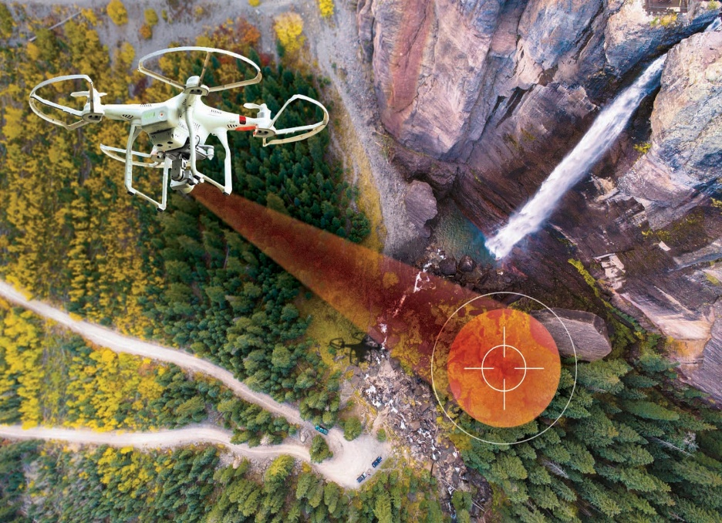
SEARCH AND RESCUE
DURING THE 2008 HURRICANES THAT STUCK LOUISIANA AND TEXAS, MICRO UAVs, SUCH AS THE ‘AERYON SCOUT’, HAVE BEEN USED TO PERFORM SUCH AS MISSING PERSONS
PREDATORS , OPERATING UPTO 29.000 FEET ABOVE SEA LEVEL, PERFORMED SEARCH, RESCUE AND DAMAGE ASSESSMENT

Slide 16
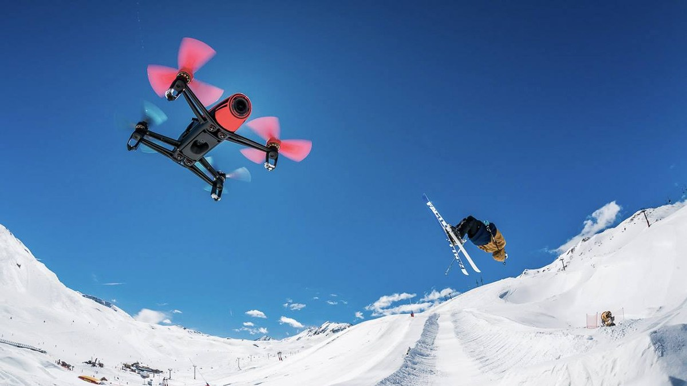
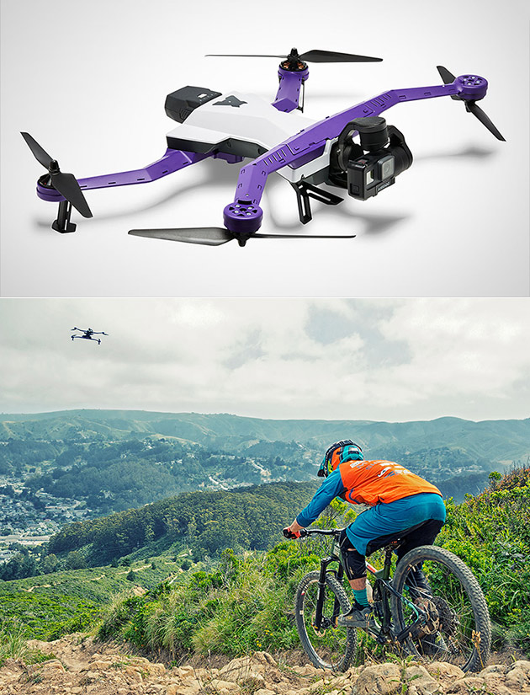
SPORTS
DRONES WERE USED IN THE 2014 WINTER OLYMPICS IN SOCHI FOR FILMING SKILLING AND SNOWBOARDING EVENTS
SOME ADVANTAGES OF USING UAV IN SPORTS ARE THAT THEY ALLOW CAMERAS TO GET CLOSER TO THE ATHLETES
THEY ARE MORE FLEXIBLE THAN CABLE – SUSPENDED CAMERA SYSTEM

Slide 17
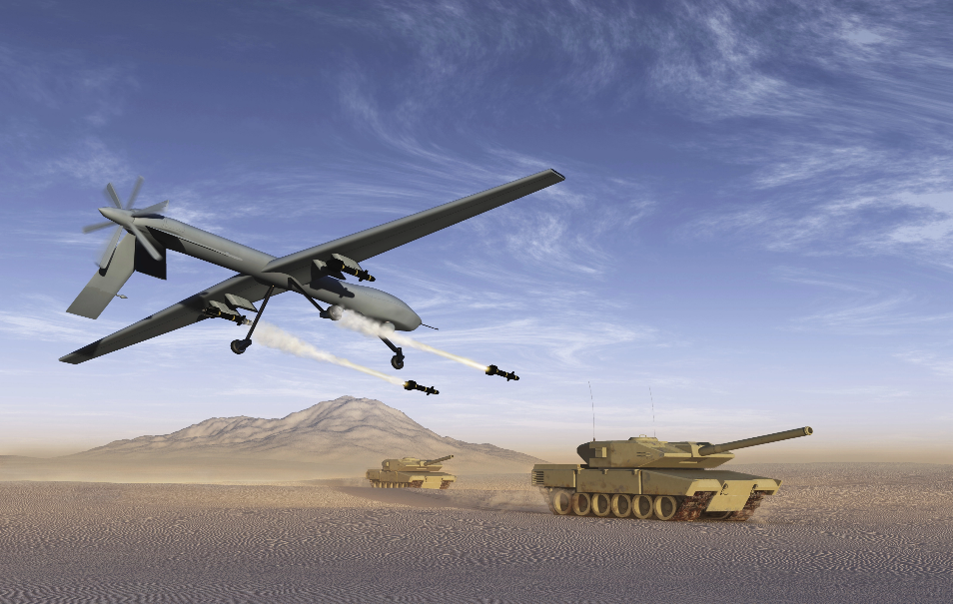
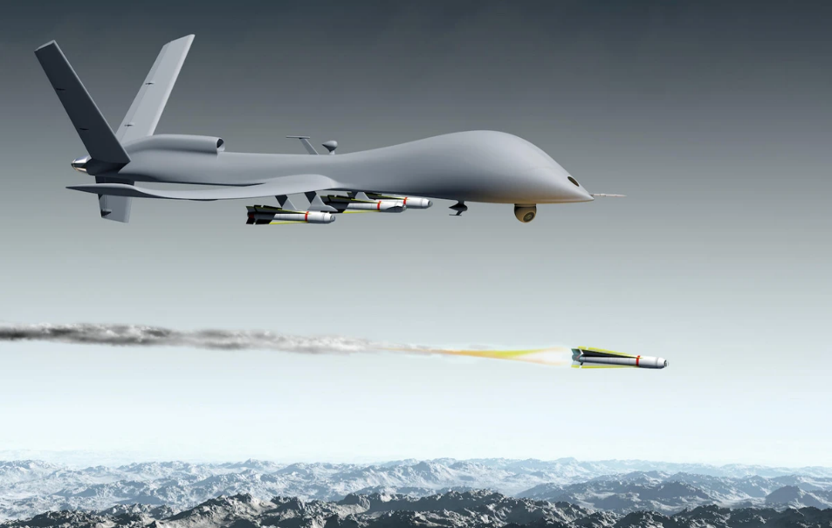
ARMED ATTACKS
ARMED ‘PREDATORS’ WERE FIRST USED IN LATE 2001 FROM BASES IN PAKISTAN AND UZBEKISTAN, MOSTLY AIMED AT ASSASSINATING HIGH PROFILE INDIVIDUALS (TERRORIST LEADERS, ETC) INSIDE AFGANISTAN
A PREDATOR BASED IN A NEIGHBORING ARAB COUNTRY WAS USED TO KILL SUSPECTED AL-QUAEDA TERRORISTS IN YEMEN ON 03 NOV 2002

Slide 18
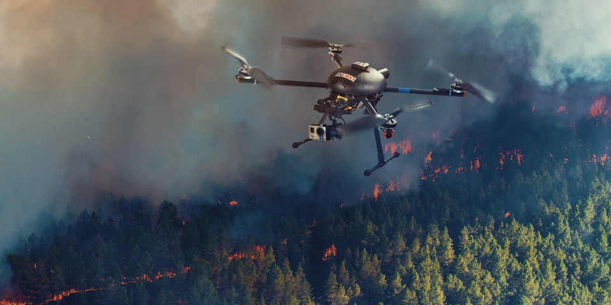
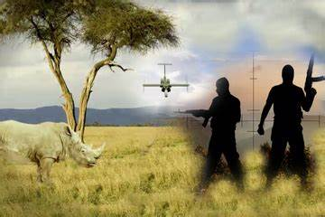
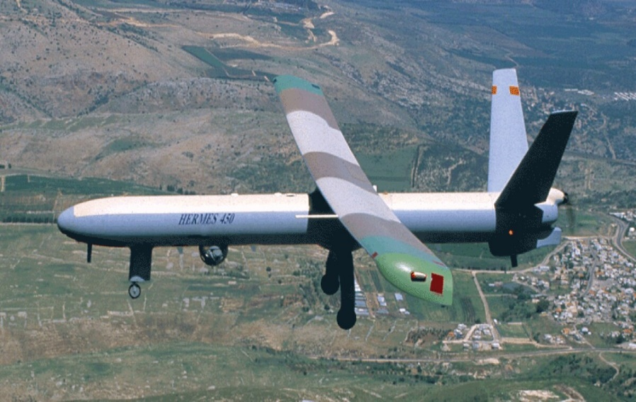
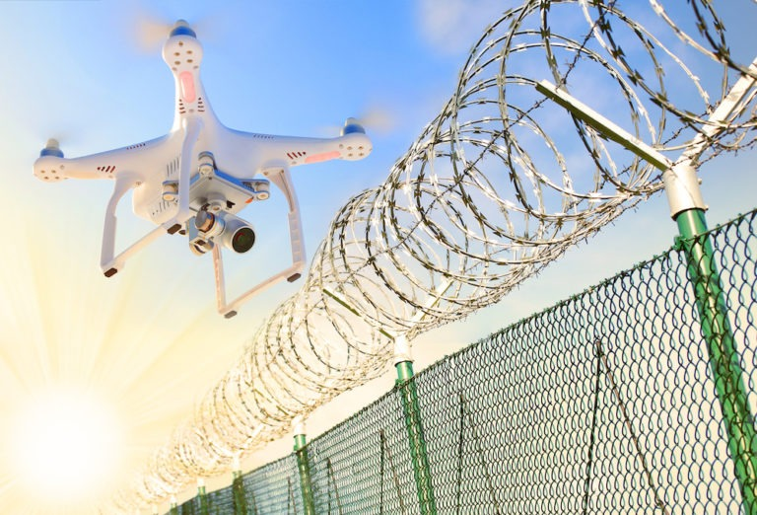
APPL
FOREST FIRE DETECTION
DETECTION OF ILLIGAL HUNTING
SURVEILLANCE & BORDER PATROL

Slide 19
DEMERITS
CIVILIAN CASUALTIES
CAN BE HACKED OR GIVEN VIRUSES
TOO SMALL FOR TRANSPOTATION OF LARGE MATERIALS
LOW RESISTANCE TO WEATHER
CANNOT REFUEL IN FLIGHT
IF CONTACT IS LOST WITH THE GROUND STATION, THE VEHICLE MAY BE LOST (not applicable for Switch)

Slide 20
CHALLENGES

Slide 21
CONCLUSION
UAVs ARE USED FOR OBSERVATION AND TACTICAL PLANNING , THIS TECHNOLOGY IS NOW AVAILABLE FOR USE IN THE EMERGENCY RESPONSE TO ASSIST CREW MEMBERS THESE ARE SUPPORT A WIDE RANGE OF APPLICATIONS INCLUDING MILITARY AND COMMERCIAL APPLICATIONS TO RECORD INFORMATION AND CAPTURING PHOTOS WHERE SOLDIERS CANNOT, SUCH AS IN DANGEROUS ENVIRONMENT. THE NATIONAL SOCIETY ALSO USING AND PLAN TO USE LIKE SWITCH UAV. SO THESE ARE THE EVIDENCE THAT UAVS ARE USEFUL.

Slide 22
ANY QUESTION ?

Slide 23
Kjnn
Kjnn
JAI HIND

Slide 24
APPL
ANTI TERROR : Detect threats and identify risk-prone areas from a remote location.
BORDER SECURITY : Conduct reconnaissance missions and track illegal activities without risking lives
COUNTER INSURGENCY : Conduct surveillance and gather actionable intelligence
CRIME CONTROL : Enhance law enforcement with remote situation assessment and crime scene analysis.
CROWD MONITORING : Detect irregular activity and gain in-depth situational awareness.
DISASTER MANAGEMENT : Gain real-time knowledge of the situation and plan search and rescue operations effectively
FOREST & WILDLIFE : Track criminal activity and boost conservation efforts
TRAFFIC MONITORING : Analyze and control traffic movement and respond to emergencies more effectively
PRECISION AGRICULTURE : Analyze crop growth pattern and inspect crops for diseases quickly
CONSTRUCTION & REAL ESTATE : Inspect buildings, bridges, rail lines and other infrastructure without scaffolding or booms.
INDUSTRIAL ASSET INSPECTION : Examine solar farms and detect anomalies with fewer or no personnel
MINING : Use aerial surveys and photogrammetry to improve blast optimization

Slide 25
Founded in 2007 by IIT-Bombay alumni, the organization has a consistent market share of over 90% in Security & Surveillance segment.
The organization is a licensed manufacturer of UAVs approved by Ministry of Defence (MoD).
ideaForge is the first organization to indigenously develop and manufacture Vertical Take-off and Landing (VTOL) UAVs in India.
It is the pioneer in the UAV industry in India and has multiple IPs to its credit, including the then world’s lightest autopilot in 2009.
Currently, the organization has deployed over 1000 systems and has trained over 1400 pilots in services including Indian Army, Navy, Air-Force, all CAPFs (CRPF, BSF, NSG, etc).
FAIL-SAFE FEATURES
Multiple GPS for redundancy
Return home on low battery
Return home on high winds

Slide 26
The Indian Army has signed a $20-million contract with ideaForge, a player in unmanned aerial vehicle (UAV) technology
Indian army will procure undisclosed quantities of a high-altitude variant of SWITCH UAV, an indigenous system used in surveillance operations.
SWITCH UAV
SWITCH UAV is an indigenous system built to cater to the most demanding surveillance operations of the Indian forces.
This fixed-wing vertical take-off and landing UAV can be deployed at high altitudes and under harsh environments for day and night surveillance.
UAV player ideaForge has been awarded this one-year contract after it qualified the operational requirements in an evaluation done in real-world conditions.
The contract marks a strategic shift in the Indian defence procurement process.
SWITCH UAV is a first of its kind VTOL and fixed wing hybrid Unmanned Aerial Vehicle.

